Slide 1

Welcome to CS149 Students to….
THE FOURTH HOUR
TOPIC - Input and Output
Notes:
While students are filtering in, circulate a piece of paper for students to write their names on. Include a place for name and professor. If a student came in late, note what time they came in so that we can accurately track data. (The observing TA should probably be the one to manage and record when a student comes in late)

Slide 2
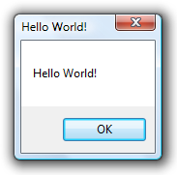
Introductions
Name
Professor
Fun Fact About yourself

Slide 3
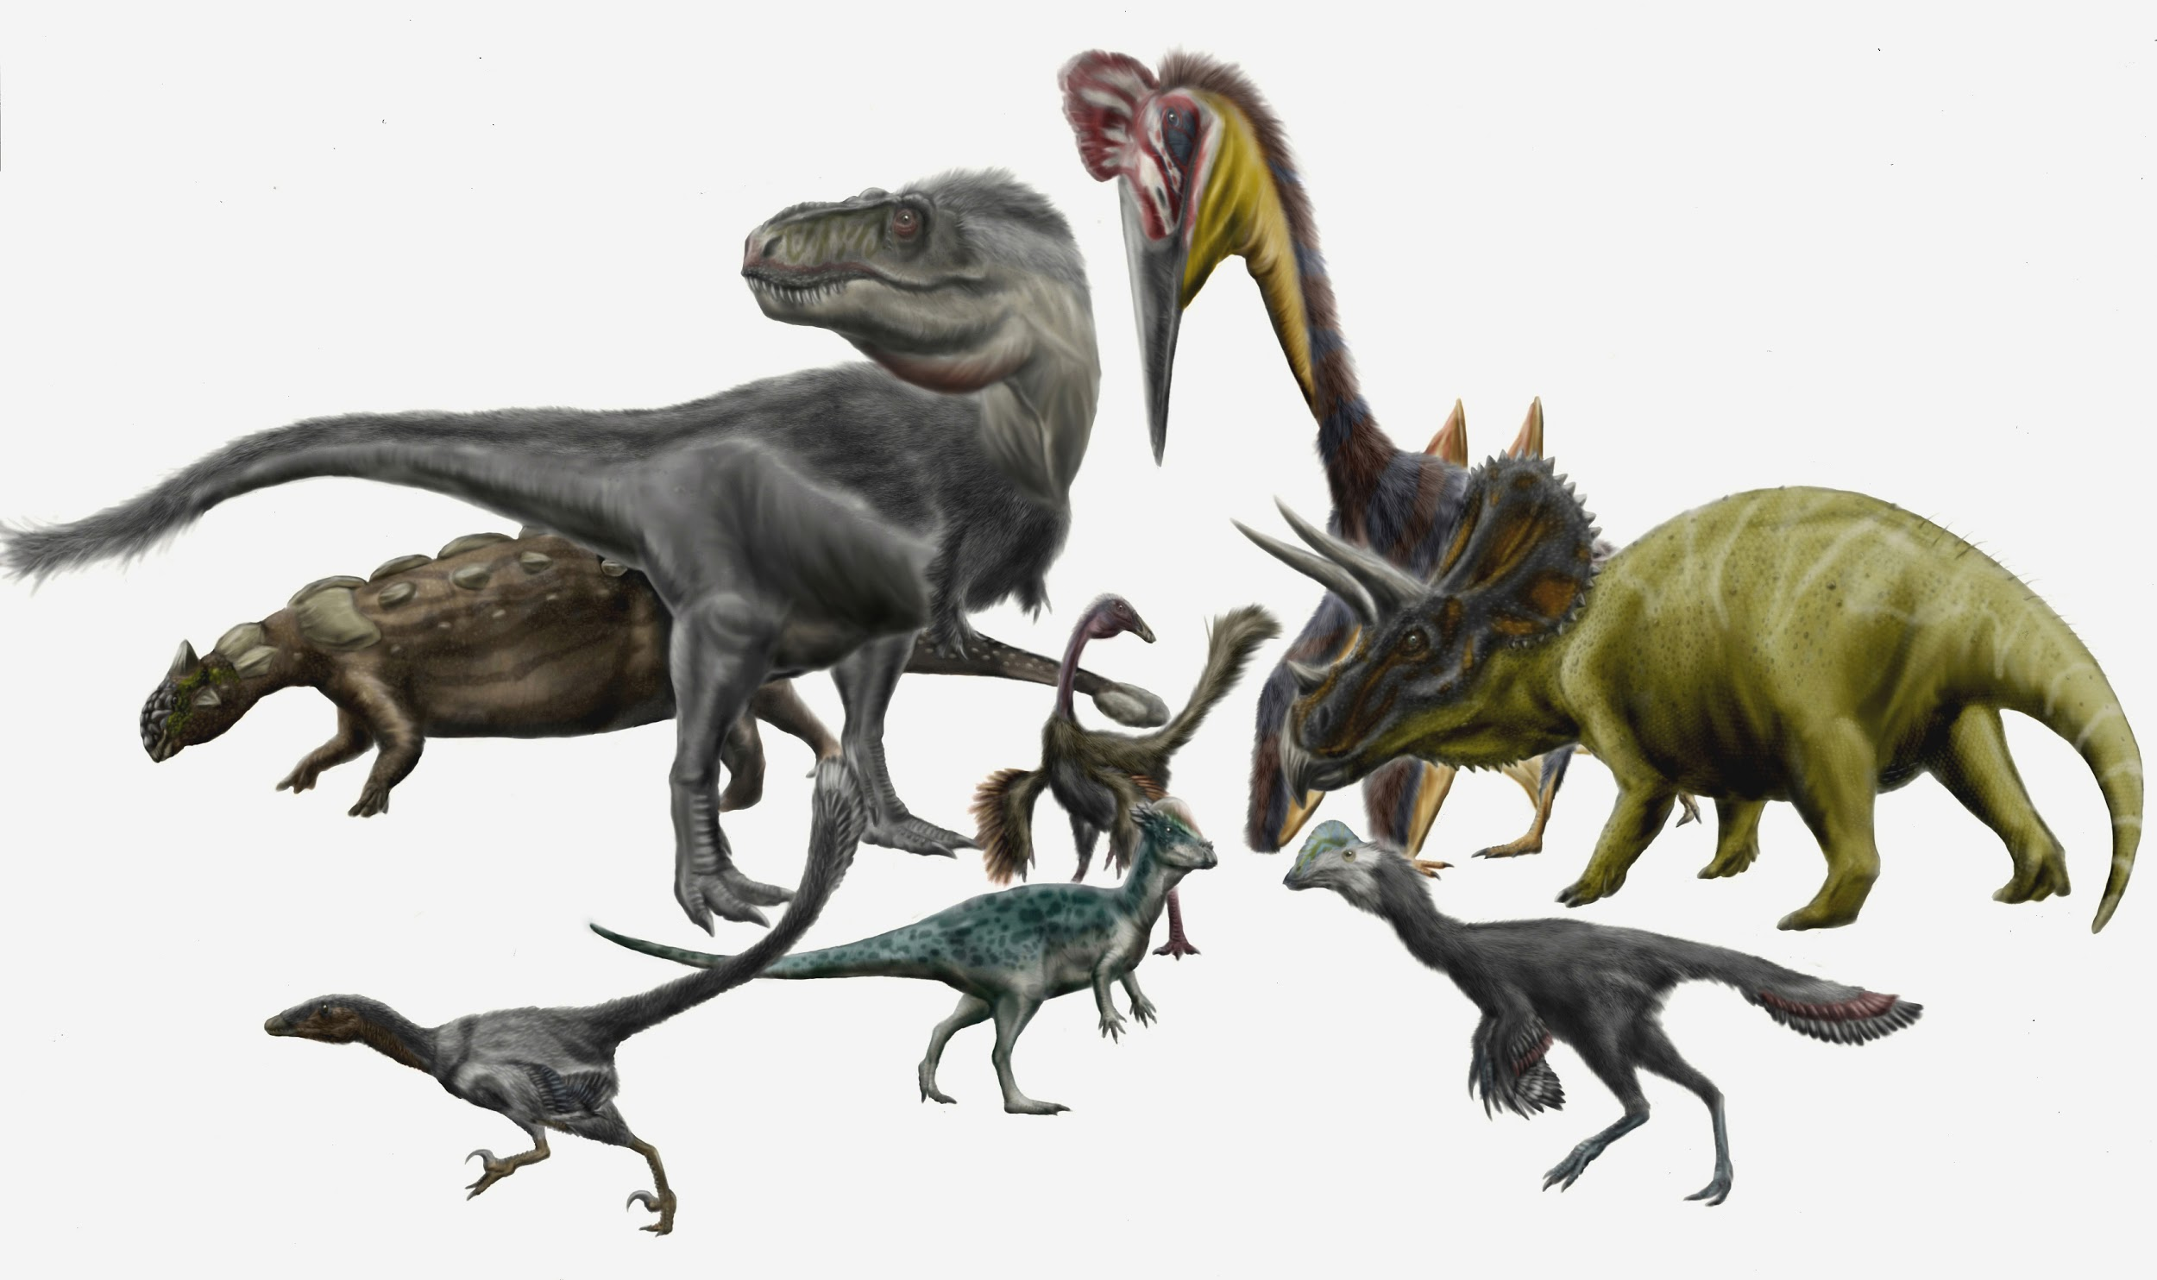


What did we learn last week
Primitive Types
Scanner
Formatting Output

Slide 4
What are primitive types?
Hint there are 8 different types

Slide 5
What are primitive the types?
Keyword | Size
byte | 1 byte
short
int
long
float
double
boolean
char

Slide 6
What are primitive the types?
Keyword | Size
byte | 1 byte
short | 2 bytes
int
long
float
double
boolean
char

Slide 7
What are primitive the types?
Keyword | Size
byte | 1 byte
short | 2 bytes
int | 4 bytes
long
float
double
boolean
char

Slide 8
What are primitive the types?
Keyword | Size
byte | 1 byte
short | 2 bytes
int | 4 bytes
long | 8 bytes
float
double
boolean
char

Slide 9
What are primitive the types?
Keyword | Size
byte | 1 byte
short | 2 bytes
int | 4 bytes
long | 8 bytes
float | 4 bytes
double
boolean
char

Slide 10
What are primitive the types?
Keyword | Size
byte | 1 byte
short | 2 bytes
int | 4 bytes
long | 8 bytes
float | 4 bytes
double | 8 bytes
boolean
char

Slide 11
What are primitive the types?
Keyword | Size
byte | 1 byte
short | 2 bytes
int | 4 bytes
long | 8 bytes
float | 4 bytes
double | 8 bytes
boolean | N/A
char

Slide 12
What are primitive the types?
Keyword | Size
byte | 1 byte
short | 2 bytes
int | 4 bytes
long | 8 bytes
float | 4 bytes
double | 8 bytes
boolean | N/A
char | 2 bytes

Slide 13
Socrative Question 1
Go to https://b.socrative.com/login/student
Classroom name: FOURTHOUR

Slide 14
Socrative Question 1
What is the value of :
int x;
x doesn’t have a value
0
-1
null

Slide 15
Socrative Question 1
What is the value of :
int x;
x doesn’t have a value
0
-1
null

Slide 16
What are default values?
If a primitive type is declared and not assigned a value Java will assign it a default value

Slide 17
What are default values?
If a primitive type is declared and not assigned a value Java will assign it a default value
Primitive types that store a whole number

Slide 18
What are default values?
If a primitive type is declared and not assigned a value Java will assign it a default value
Primitive types that store a whole number, are given the value ?
byte
short
int
long

Slide 19
What are default values?
If a primitive type is declared and not assigned a value Java will assign it a default value
Primitive types that store a whole number, are given the value 0
byte
short
int
long

Slide 20
What are default values?
If a primitive type is declared and not assigned a value Java will assign it a default value
Primitive types that store a whole number, are given the value 0
byte
short
int
long
Primitive types that store a decimal number

Slide 21
What are default values?
If a primitive type is declared and not assigned a value Java will assign it a default value
Primitive types that store a whole number, are given the value 0
byte
short
int
Long
Primitive types that store a decimal number
float
double

Slide 22
What are default values?
If a primitive type is declared and not assigned a value Java will assign it a default value
Primitive types that store a whole number, are given the value 0
byte
short
int
Long
Primitive types that store a decimal number, are given the value ?
float
double

Slide 23
What are default values?
If a primitive type is declared and not assigned a value Java will assign it a default value
Primitive types that store a whole number, are given the value 0
byte
short
int
Long
Primitive types that store a decimal number, are given the value 0.0
float
double

Slide 24
What are default values?
If a primitive type is declared and not assigned a value Java will assign it a default value
Primitive types that store a whole number, are given the value 0
byte
short
int
Long
Primitive types that store a decimal number, are given the value 0.0
float
double
Other
char
boolean

Slide 25
What are default values?
If a primitive type is declared and not assigned a value Java will assign it a default value
Primitive types that store a whole number, are given the value 0
byte
short
int
Long
Primitive types that store a decimal number, are given the value 0.0
float
double
Other
char ‘\u0000’
boolean false

Slide 26
Time for a quick activity! Does it fit?
Keyword | Size
byte | 1 byte
short | 2 bytes
int | 4 bytes
long | 8 bytes
float | 4 bytes
double | 8 bytes
boolean | N/A
char | 2 bytes
int x = 500;
double y = x
double e = 50.0
float f = e;
byte i = 5;
double h = i;
double a = 500.0;
int b = a;
float c = 50.0f
double d = c;

Slide 27
Time for a quick activity! Does it fit?
Keyword | Size
byte | 1 byte
short | 2 bytes
int | 4 bytes
long | 8 bytes
float | 4 bytes
double | 8 bytes
boolean | N/A
char | 2 bytes
int x = 500;
double y = x
double e = 50.0
float f = e;
byte i = 5;
double h = i;
double a = 500.0;
int b = a;
float c = 50.0f
double d = c;

Slide 28

One more byte pleeeasee…..

Slide 29
Socrative Question 2
What is true about primitive types and objects.
Primitive types store a value while objects store a reference in memory
On declaration both primitive and object types are allocated all their memory
Primitive types take up no memory
Primitive and object types both store values only

Slide 30
Socrative Question 2
What is true about primitive types and objects.
Primitive types store a value while objects store a reference in memory
On declaration both primitive and object types are allocated all their memory
Primitive types take up no memory
Primitive and object types both store values only

Slide 31
State Diagram
public class ReviewSession {
public static void main(String[] args) {
int num;
double d;
String message;
num = 5;
d = num + 3.0;
message = “hello”;
}
}

Slide 32
State Diagram
main
public class ReviewSession {
public static void main(String[] args) {
int num;
double d;
String message;
num = 5;
d = num + 3.0;
message = “hello”;
}
}
num

Slide 33
State Diagram
main
public class ReviewSession {
public static void main(String[] args) {
int num;
double d;
String message;
num = 5;
d = num + 3.0;
message = “hello”;
}
}
num
0

Slide 34
State Diagram
main
public class ReviewSession {
public static void main(String[] args) {
int num;
double d;
String message;
num = 5;
d = num + 3.0;
message = “hello”;
}
}
num
d
0

Slide 35
State Diagram
main
public class ReviewSession {
public static void main(String[] args) {
int num;
double d;
String message;
num = 5;
d = num + 3.0;
message = “hello”;
}
}
num
d
0
0.0

Slide 36
State Diagram
main
public class ReviewSession {
public static void main(String[] args) {
int num;
double d;
String message;
num = 5;
d = num + 3.0;
message = “hello”;
}
}
num
d
message
0
0.0

Slide 37
State Diagram
main
public class ReviewSession {
public static void main(String[] args) {
int num;
double d;
String message;
num = 5;
d = num + 3.0;
message = “hello”;
}
}
num
d
message
0
0.0

Slide 38
State Diagram
main
public class ReviewSession {
public static void main(String[] args) {
int num;
double d;
String message;
num = 5;
d = num + 3.0;
message = “hello”;
}
}
num
d
message
0
0.0

Slide 39
State Diagram
main
public class ReviewSession {
public static void main(String[] args) {
int num;
double d;
String message;
num = 5;
d = num + 3.0;
message = “hello”;
}
}
num
d
message
5
0.0

Slide 40
State Diagram
main
public class ReviewSession {
public static void main(String[] args) {
int num;
double d;
String message;
num = 5;
d = num + 3.0;
message = “hello”;
}
}
num
d
message
5
0.0

Slide 41
State Diagram
main
public class ReviewSession {
public static void main(String[] args) {
int num;
double d;
String message;
num = 5;
d = num + 3.0;
message = “hello”;
}
}
num
d
message
5
8.0

Slide 42
State Diagram
main
public class ReviewSession {
public static void main(String[] args) {
int num;
double d;
String message;
num = 5;
d = num + 3.0;
message = “hello”;
}
}
num
d
message
5
8.0

Slide 43
State Diagram
main
public class ReviewSession {
public static void main(String[] args) {
int num;
double d;
String message;
num = 5;
d = num + 3.0;
message = “hello”;
}
}
num
d
message
5
8.0
hello

Slide 44
Socrative Question 3
What is the value of:
String a;
“ “
“”
“a”
null
Notes:
“ “ and “” are both different
When we System.out.println(“ “); this is not a blank line we are really printing a space and then a new line
When we System.out.println(“”); then we are just printing a new line

Slide 45
Socrative Question 3
What is the value of:
String a;
“ “
“”
“a”
null

Slide 46
Final Activity
Break up into groups of 2-3.
Each group will be given four code snippets.
Discuss the differences and similarities between each snippet of code
Are any of the snippets incorrect (hint 2 are incorrect)
After 5 min we will come back together and discuss

Slide 47
Key points of Activity
Understanding the scanner bug and recognizing it in code
After using the scanner to read in an int or double we need to read in the newline character

Slide 48
Key points of Activity
Understanding the scanner bug and recognizing it in code
After using the scanner to read in an int or double we need to read in the newline character
User types 5 then enter
import java.util.Scanner;
public class ReviewSession {
public static void main(String[] args) {
int num;
String color;
Scanner in = new Scanner(System.in);
System.out.print("Pick a whole number: ");
num = in.nextInt();
System.out.print("Pick a color: ");
color = in.nextLine();
System.out.printf("%d %s ballons\n", num,
color);
}
}
5 | \n
Notes:
Write stack diagram on the board while going through this activity

Slide 49
Key points of Activity
Understanding the scanner bug and recognizing it in code
After using the scanner to read in an int or double we need to read in the newline character
User types 5 then enter
import java.util.Scanner;
public class ReviewSession {
public static void main(String[] args) {
int num;
String color;
Scanner in = new Scanner(System.in);
System.out.print("Pick a whole number: ");
num = in.nextInt();
System.out.print("Pick a color: ");
color = in.nextLine();
System.out.printf("%d %s ballons\n", num,
color);
}
}
5 | \n

Slide 50
Key points of Activity
Understanding the scanner bug and recognizing it in code
After using the scanner to read in an int or double we need to read in the newline character
User types 5 then enter
import java.util.Scanner;
public class ReviewSession {
public static void main(String[] args) {
int num;
String color;
Scanner in = new Scanner(System.in);
System.out.print("Pick a whole number: ");
num = in.nextInt();
System.out.print("Pick a color: ");
color = in.nextLine();
System.out.printf("%d %s ballons\n", num,
color);
}
}
5 | \n

Slide 51
Key points of Activity
Understanding the scanner bug and recognizing it in code
After using the scanner to read in an int or double we need to read in the newline character
User types 5 then enter
import java.util.Scanner;
public class ReviewSession {
public static void main(String[] args) {
int num;
String color;
Scanner in = new Scanner(System.in);
System.out.print("Pick a whole number: ");
num = in.nextInt();
System.out.print("Pick a color: ");
color = in.nextLine();
System.out.printf("%d %s ballons\n", num,
color);
}
}
5 | \n

Slide 52
Key points of Activity
Understanding the scanner bug and recognizing it in code
After using the scanner to read in an int or double we need to read in the newline character
User types 5 then enter
Prompts user to pick color
But doesn’t let them type
anything b/c reads \n instead
import java.util.Scanner;
public class ReviewSession {
public static void main(String[] args) {
int num;
String color;
Scanner in = new Scanner(System.in);
System.out.print("Pick a whole number: ");
num = in.nextInt();
System.out.print("Pick a color: ");
color = in.nextLine();
System.out.printf("%d %s ballons\n", num,
color);
}
}
5 | \n

Slide 53
Key points of Activity
Understanding the scanner bug and recognizing it in code
After using the scanner to read in an int or double we need to read in the newline character
User types 5 then enter
Prompts user to pick color
But doesn’t let them type
anything b/c reads \n instead
import java.util.Scanner;
public class ReviewSession {
public static void main(String[] args) {
int num;
String color;
Scanner in = new Scanner(System.in);
System.out.print("Pick a whole number: ");
num = in.nextInt();
System.out.print("Pick a color: ");
color = in.nextLine();
System.out.printf("%d %s ballons\n", num,
color);
}
}
5 | \n

Slide 54
Key points of Activity
Understanding that you must use printf for any formatting
print and println do not format numbers (no rounding decimal points or padding)
What is a good reference for printf
Check out the textbook there is an awesome table about using printf

Slide 55

Questions?

